Slide 1




Slide 2


THANK YOU

Slide 3

2026 ICA Talent Poll: What We Learned
Top Appealing Aspects
  Small town feel
  59% believe Iowa has a lower cost of living
  62% believe Iowans are friendlier
  68.5% of Iowans believe Iowa is safer
Institutional Trust
  Small business and employers are most trusted
Right Direction
  48% right direction believe versus 39% wrong track
Growing Pessimism
  Standard of living, achieving long term goals and consideration of relocation
Priorities
  Stopping inflation and rising cost of living along with lowering property taxes

Slide 4

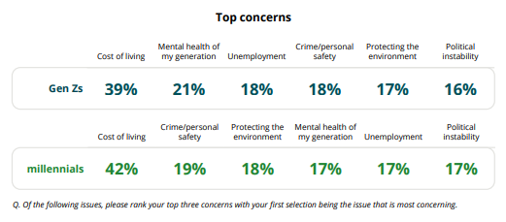
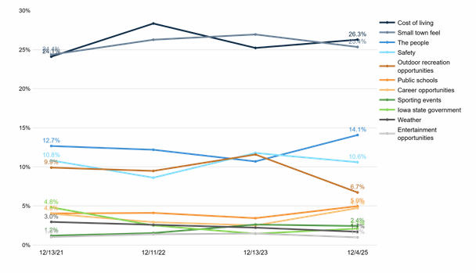
WHY IOWA?

Slide 5
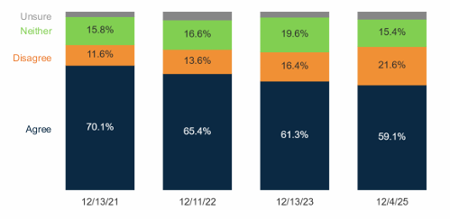
IOWA IS LESS EXPENSIVE

Slide 6

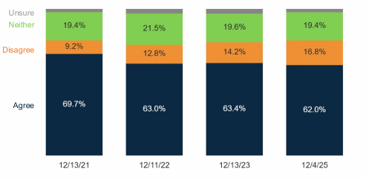
I THINK THE PEOPLE IN IOWA ARE FRIENDLIER AND MORE PLEASANT

Slide 7
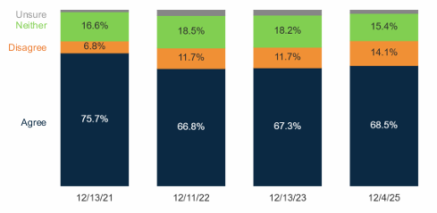
IOWA IS SAFER THAN MOST OTHER STATES

Slide 8
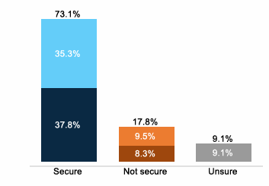
JOB SECURITY

Slide 9
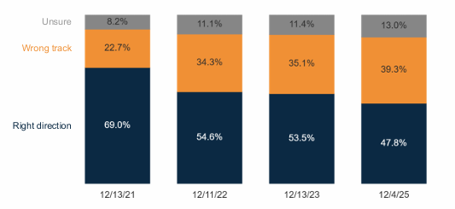
RIGHT DIRECTION

Slide 10
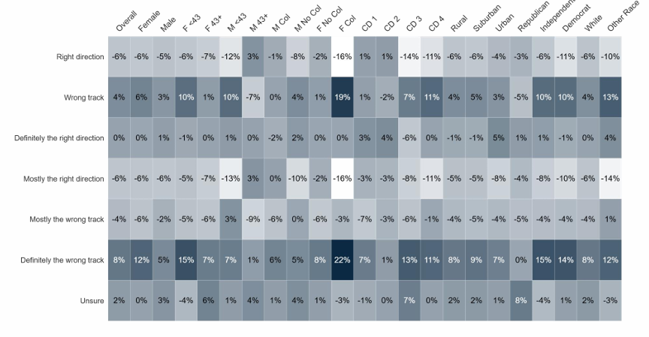
% CHANGE: STATE DIRECTION (2023-2025)

Slide 11
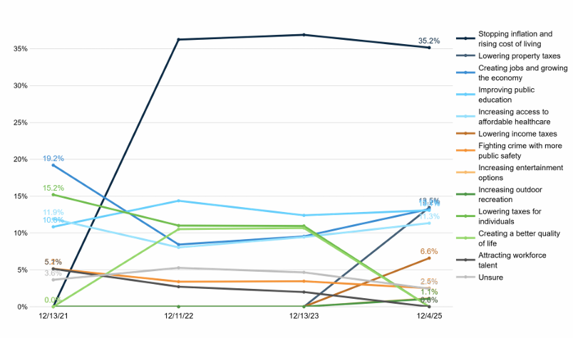
TOP PRIORITIES

Slide 12
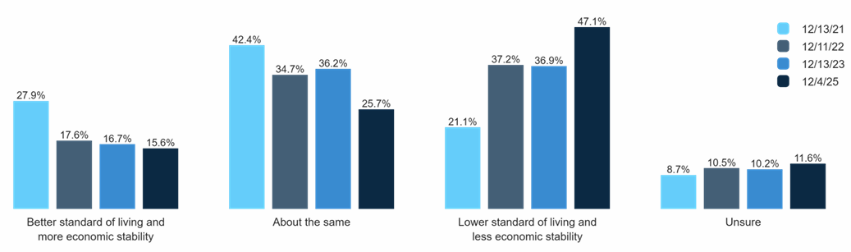
FUTURE OUTLOOK

Slide 13
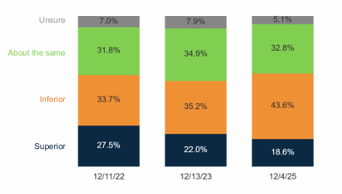
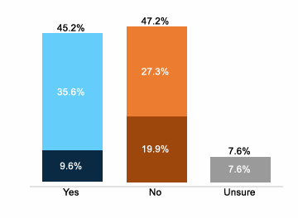
OPPORTUNITY
ECONOMIC
CAREER GROWTH

Slide 14
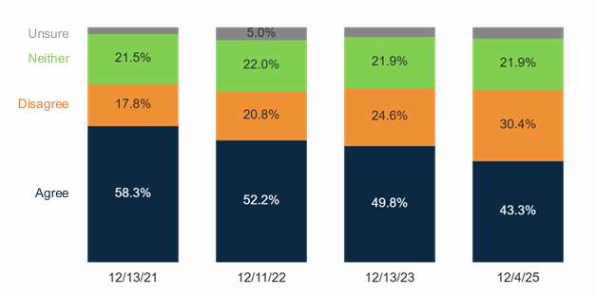
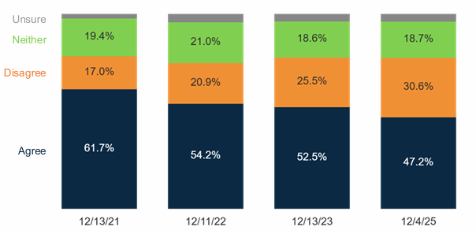
CAN I ACHIEVE MY LONG-TERM GOALS IN IOWA?
CAREER
LIFE

Slide 15
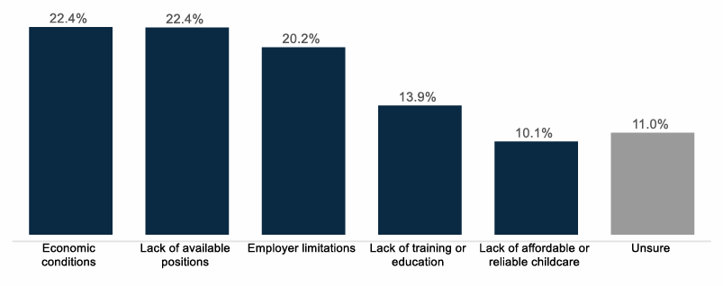
BARRIERS TO GROWTH

Slide 16
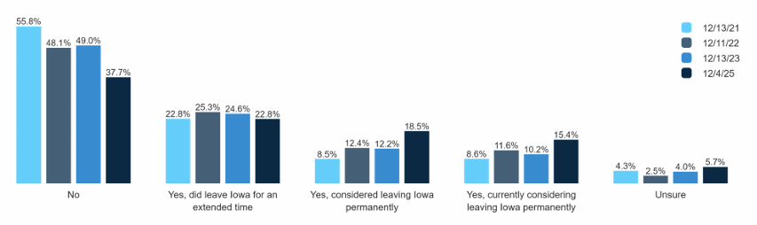
CONSIDERED LEAVING?
#1 Reason is Job Opportunies / Career Growth

Slide 17
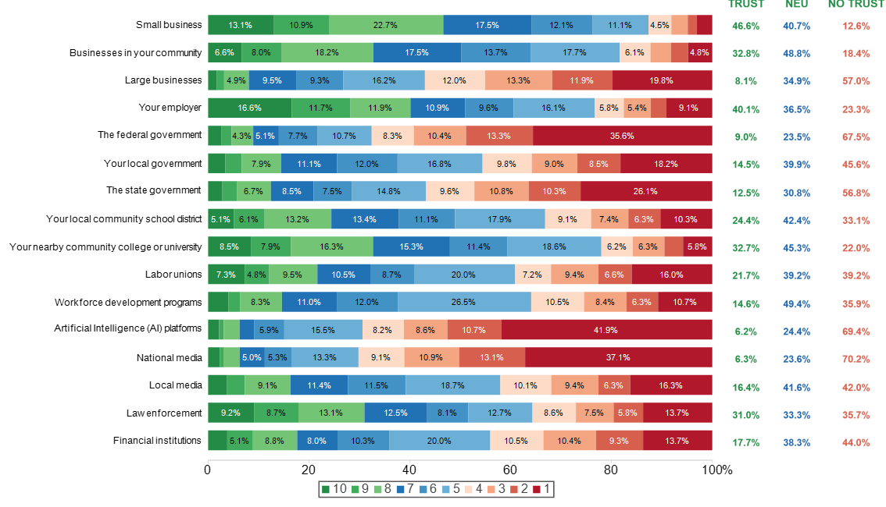
INSTITUTION’S TRUST

Slide 18
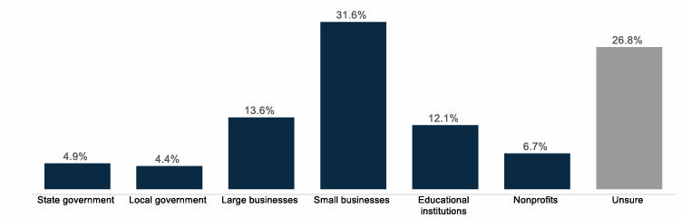
WHO INVESTS IN IOWA WORKERS?

Slide 19
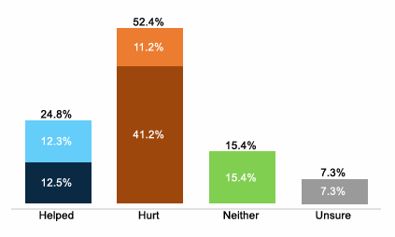
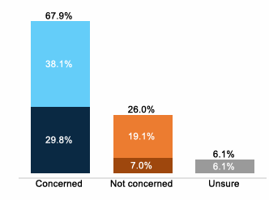
CONCERNS
TARIFFS
ARTIFICIAL INTELLIGENCE

Slide 20
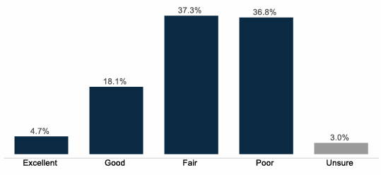
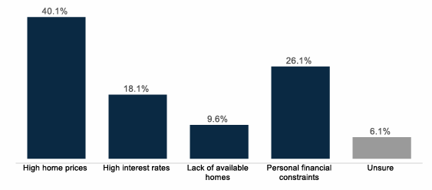
HOUSING
AFFORDABLE HOUSING
BARRIER TO OWNERSHIP

Slide 21
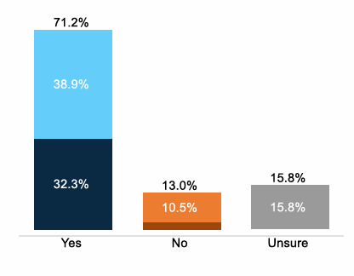
BRAIN DRAIN
DOES IOWA LOSE TOO MANY EDUCATED WORKERS TO OTHER STATES?

Slide 22
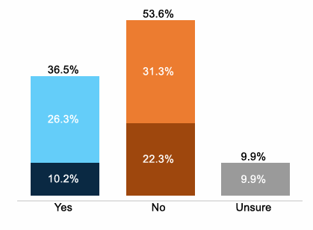
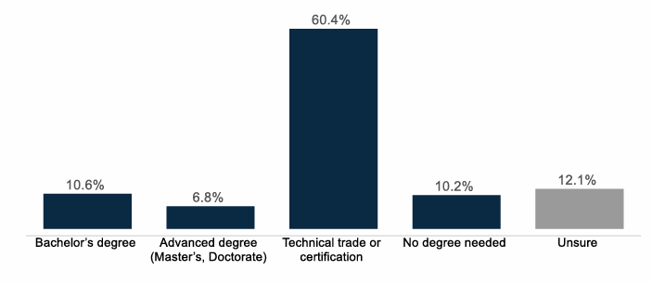
HIGHER ED VALUE
IS IT WORTH IT?
MOST VALUABLE?

Slide 23


More Information on the ICA Talent Poll can be found at
IowaChamberAlliance.com

